Slide 1
Cnn architectures
ImageNet Large Scale Visual Recognition Challenge
Gene Olafsen

Slide 2
LeNet-5
1998 created by Yann LeCun for handwritten digit recognition
MNIST digits are padded from 28x28 to 32x32
Complex pooling – computes the mean of its inputs and then multiplies the result by a learnable coefficient (one per map) and then adds a learnable bias term (one per map) and then applies an activation function.
C3 maps don't connect to all previous pooling layers- three or four instead of all six.
The output layer is special... see next slide.

Slide 3
LeNet-5 Output layer
The output layer computes the dot product of the inputs and the weight vector, each neuron outputs the square of the Euclidian distance between its input vector and its weight vector. Each output measures how much the image belongs to a particular digit class.
The cross entropy cost function is now preferred, as it penalizes bad predictions, producing larger gradients and thus faster convergence.
http://ml-cheatsheet.readthedocs.io/en/latest/loss_functions.html (Cost function cheat sheet)

Slide 4
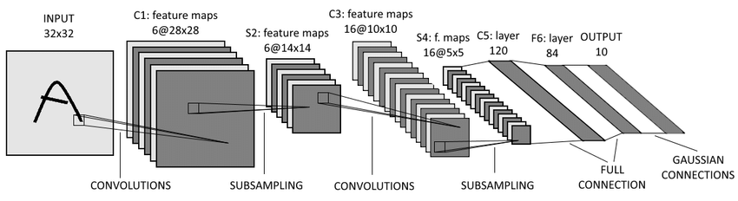
LENET-5
a

Slide 5
ImageNet
The ImageNet project is a large visual database designed for use in visual object recognition software research. The ImageNet project runs an annual software contest, the ImageNet Large Scale Visual Recognition Challenge (ILSVRC).

Slide 6
Alexnet
AlexNet – won the 2012 ImageNet ILSVRC challenge. Developed by Alex Krizhevsky, IIya Sutskever and Geoffrey Hinton.
Similar to LeNet-5 only larger and deeper
First to stack convolution layers (instead of inserting pooling layers)
Used two regularizers (see slide deck on Regularizers)
Dropout of 50%
Data augmentation of images

Slide 7
Local Response Normalization
AlexNet utilizes a competitive normalization step after the ReLU step in layers C1 and C3.
Similar to biological neurons, this form of normalization makes the neurons that most strongly activate inhibit neurons at the same location but in neighboring feature maps.
This encourages different feature maps to specialize, pushing them further apart and forcing them to explore a wider range of features- ultimately improving generalization.
For example: If a neuraon has strong activation, it will inhibit activation of the neurons located in the feature maps immediately above and below its own.

Slide 8
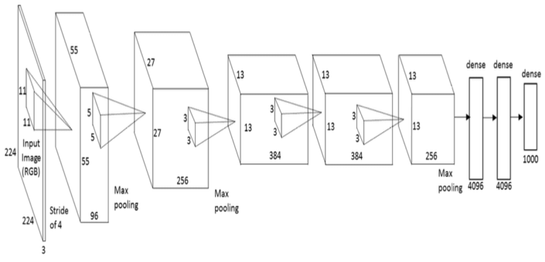
Alexnet

Slide 9
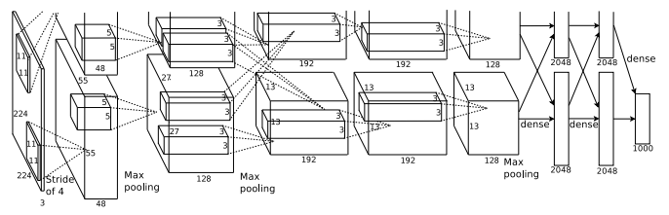
ALEXNET Pipelines
AlexNet was trained simultaneously on two Nvidia Geforce GTX 580 GPUs which is the reason for why their network is split into two pipelines

Slide 10
googlenet/Inception
GoogLeNet developed by Christian Szegedy winning ILSVRC in 2014.
Pushed the top-5 error rate below 7% using a much deeper CNN network.
Utilized sub-networks, called inception modules, permitting the more efficient use of parameters.
GoogLeNet has 10 times fewer parameters than AlexNet. (6 million vs 60 million)

Slide 11
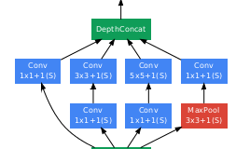
Inception Module
An inception module can be through of as convolution layer on steroids. It is able to output feature maps that can capture complex patterns at various scales.
The input signal is copied and fed to four different layers.

Slide 12
Inception Module
All the convolution layers utilize ReLU activation.
All layers use:
Stride =1
SAME padding (even for the MaxPool layer) thus outputs have same width/height as inputs- making it possible to concatenate all outputs along the same depth dimension in DeptConcat Layer
There are three different kernel sizes: 1x1, 3x3 and 5x5.
The different size kernels allow the model to capture patterns at different scales.

Slide 13
1x1 convolution layer explained
Reduce dimensionality and act as bottleneck layers. They are placed before the 3x3 and 5x5 convolutions.
Each pair of convolution layers ([1x1,3x3] and [1x1,5x5]) act as a single powerful convolution layer- capturing more complex patterns.

Slide 14
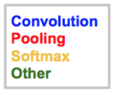
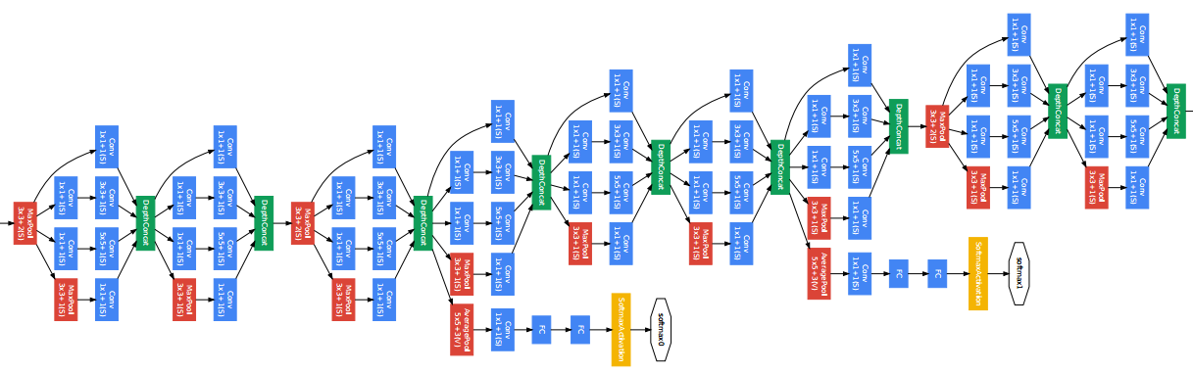
googlenet

Slide 15
Resnet
Residual Neural Network (ResNet) by Kaiming He et al introduced a novel architecture with “skip connections” and features heavy batch normalization.
ResNet delivered top-5 error rage under 3.6% in 2015, utilizing 152 layers.

Slide 16
Skip connections and residual learning
In Skip (or Shortcut) Connections, the input connection to a layer is also added to the output layer located a bit higher up the stack.
A regular neural network initializes its weights close to zero. Skip connections output a copy of its inputs. Adding many skip connections results in the network making progress even if several layers have not started learning yet.

Slide 17
Residual units
+
A deep residual network can be seen as a stack of residual units, where each residual unit is a small neural network with a skip connection.
Layer
Layer
+
Layer
Layer

Slide 18
Residual units
+
A deep residual network can be seen as a stack of residual units, where each residual unit is a small neural network with a skip connection.
Layer
Residual
Unit
Layer
+
Layer
Residual
Unit
Layer

Slide 19
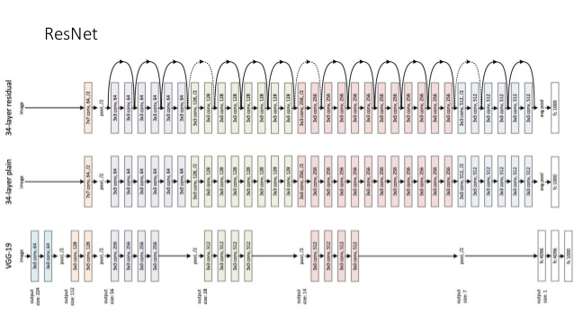

Slide 20
Resnet description
ResNet's architecture is surprisingly simple as it is mostly composed of a very deep stack of simple residual units.
The number of feature maps is doubled every few residual units, at the same time as their height and width are halved. To match up the output shape, with the next residual unit, the inputs are passed through a 1x1 convolution layer with a stride of 2 and the correct number of output feature maps.

Slide 21
Resnet and beyond
The ResNet architecture is both the most powerful and arguably the simplest- to it is highly recommended as the one to use right now.
In 2016 Trimps-Soushen team from China achieved a 2.99% error rate at the ILSVRC challenge. This feat was achieved joining new and previous trained combination models into an ensemble.

Slide 22
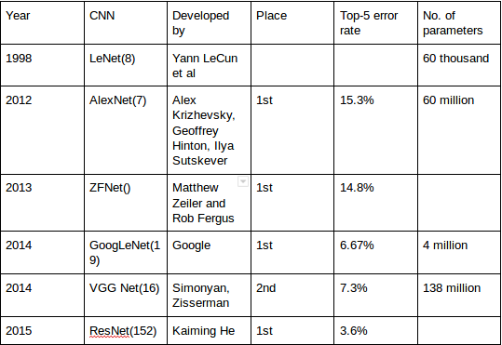
summary

